Slide 1
Modeling and Predicting Prices for Real Estate using Machine Learning
By,
Hassan Hayat
Pooshan Vyas
- Prof. Ming Hwa Wang

Slide 2
Problem Statement
More insight into the real estate/rent market
Airbnb is a site that advertises over 1.5 million short-term rent listings in 34,000 cities around the world.
Model the prices of these listings and investigate if these prices are related to the overall real estate market.

Slide 3
Relevance to Class
We applied Machine Learning techniques learned in class in order to solve this problem
We believe that we can build a robust model to predict Airbnb listing prices using Machine Learning

Slide 4
Scope
While we are interested in real estate market in general, we are particularly interested in Airbnb listing prices.
Furthermore, we are concerned with how the real estate market affects individual listings.
To do this, we use average rent price estimates for given neighborhoods from Zillow.

Slide 5
Related Project
We base our project on “Neighborhood and Price Prediction for San Francisco Airbnb Listings” by Tang, E., and Sangani, K.
Tang and Sangani also modeled Airbnb listing prices. Their approach was assumed that the main factors behind the price of a listing are the textual descriptions and the images of the room/home.
Furthermore, Tang and Sangani used exclusively Support Vector Machines as their model.

Slide 6
Solution different & better from others
We improved on their models on two fronts:
By using multiple Machine Learning algorithm models and features
By using the average rent price of the neighborhood of a listing as a feature, rather than rely on description and image.

Slide 7
Hypothesis
We seek to explore if the general real estate market has a significant effect on Airbnb listing prices
To do so, we hypothesize that average real estate prices significantly affect Airbnb listing prices.

Slide 8
Hypothesis
All models will use rent estimates from Zillow as a feature. These estimates are for Single Family Residences.
Given that we use Single Family Residences only, we may introduce bias against studios and other units that don’t qualify as Single Family Residences.

Slide 9
Methodology
We will combine all of our datasets into a single dataset with the Average rent price for Single Family Residences from Zillow as an additional feature
We split this dataset into a training and test dataset (using Scikit-Learn’s in-built functionality)
We then run the training sets on each algorithm and then use the test dataset to rank each algorithm.

Slide 10
Models
Linear Regression
Support Vector Machines
K-Nearest Neighbor
Decision Tree
Naive Bayes
Gradient Descent

Slide 11
Methodology
For evaluating algorithms, we use the following regression metrics:
Mean Absolute Error
Mean Squared Error
R² Score

Slide 12
Methodology
We also run the algorithms with and without the Avg. Rent feature in order to evaluate the strength of the feature.
This final point will be used in order to test our hypothesis that the Airbnb listing prices are dependent on average rent prices in the area.

Slide 13
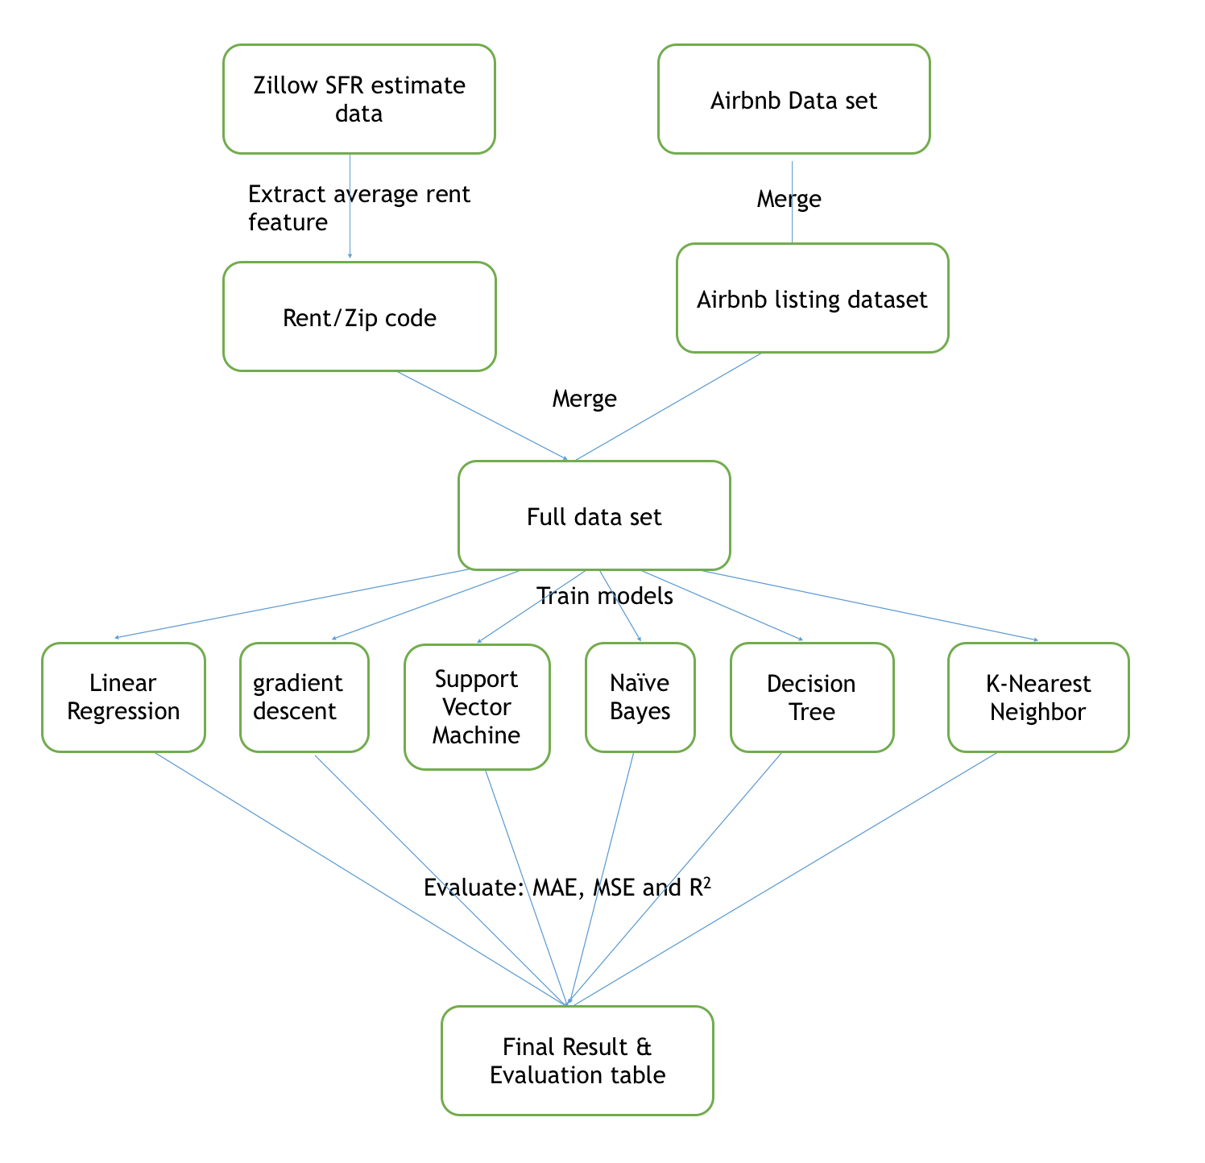
Design flow

Slide 14
Tools
Language: Python
ML Framework: Scikit-Learn
Visualization Library: matplotlib
Graph Visualization: pydotplus

Slide 15
Data Analysis & Discussion
Airbnb data is provided by InsideAirbnb.
Data is provided for multiple cities (including San Francisco and Los Angeles) in the form of .csv files containing multiple listings.
Total dataset contains 59,932 listings

Slide 16
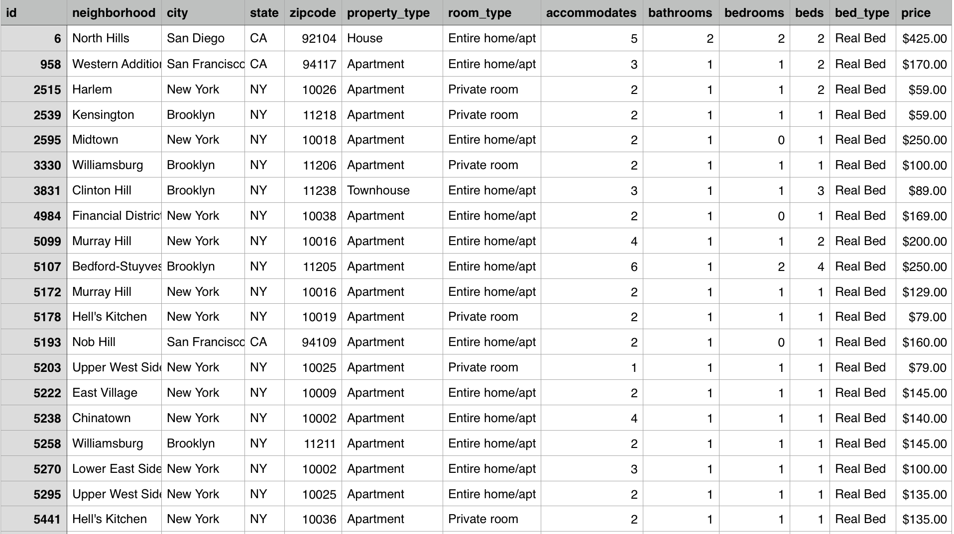
Data Analysis & Discussion

Slide 17
Data Analysis & Discussion
Rent estimates are provided by Zillow.
Zillow provides rent estimates by neighborhood, zip-code, city, county or state.
We use zip code-level estimates for Single Family Residences as the Airbnb listings also contain the zip-code information.

Slide 18
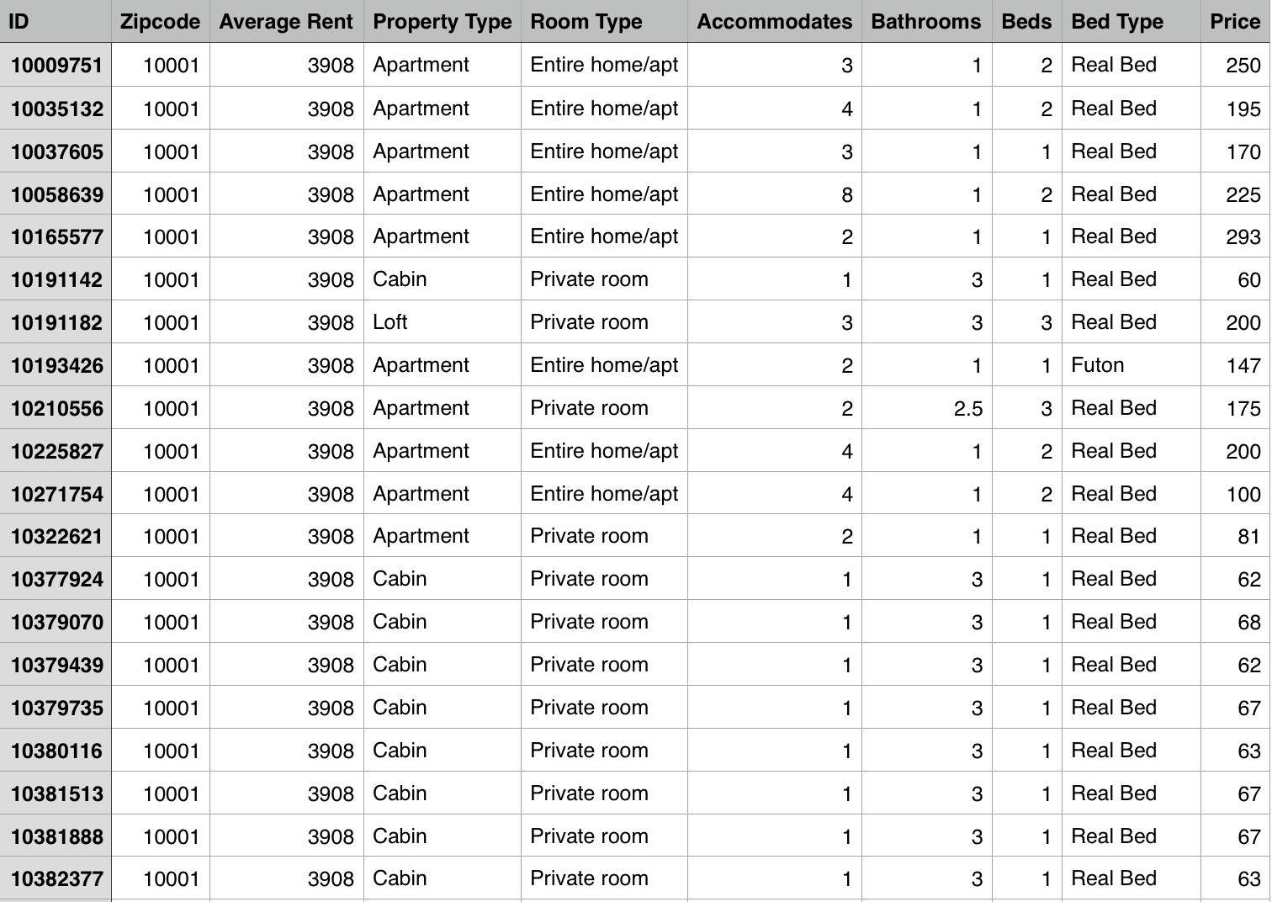
Data Analysis & Discussion

Slide 19
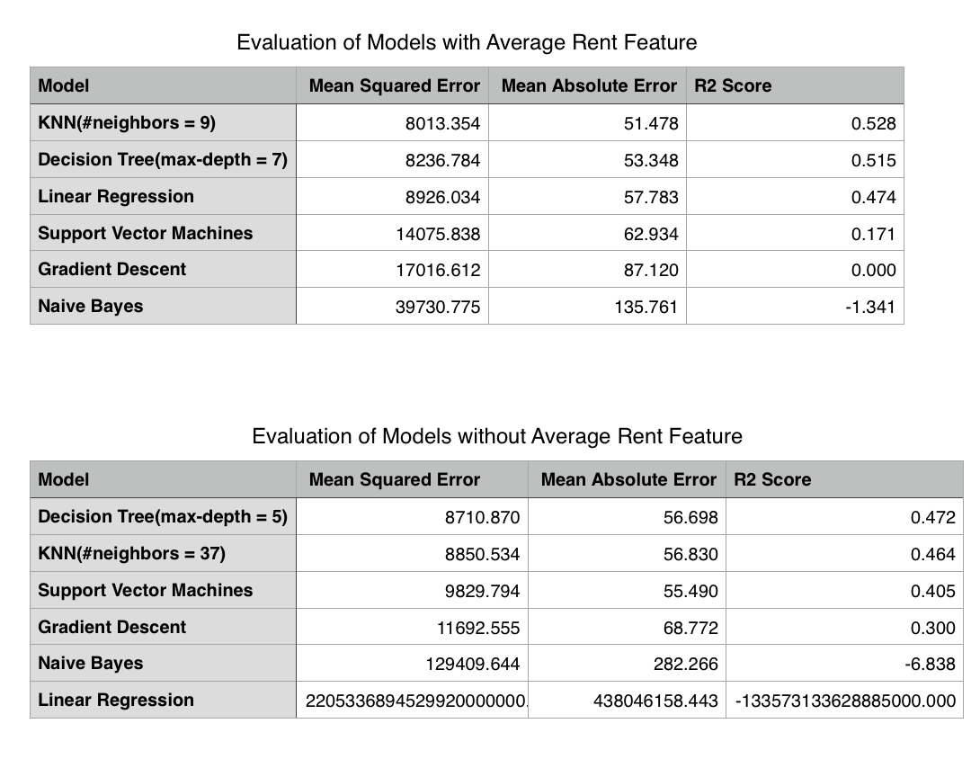
Result

Slide 20
Conclusion
Airbnb Listing prices depend on local average rent prices
Models have relatively low R2 scores and therefore cannot fully predict Airbnb Listing prices. This is due to the variation within listings.
K-Nearest Neighbor performs best for this type of task. Intuition: The price of a listing depends on similar listings.

Slide 21
Recommendation
The full Airbnb dataset contains more information that can be used for modeling, such as the presence of wifi, parking spots, review scores, etc…
This information can used to improve predictions, Abnormal cases, such as tipis and yurts, can be analyzed and thus the data can be improved.

Slide 22
Questions?
Thank you!

